Slide 1
Scrabble, the game
By Mohammad Anas Jawad, 154443
and Muhammad Saidul Islam, 154438

Slide 2
About the game
The game is as simple as it gets. All you need to do is form words. You pick a block number, you choose the character you want to place there, and done. You’ll get points equal to the length of the word you formed, provided you formed a valid word of course. It’s a two player turn-by-turn format game, so the player with the highest points at the end of the round wins. The game ends when the players decide to quit.

Slide 3
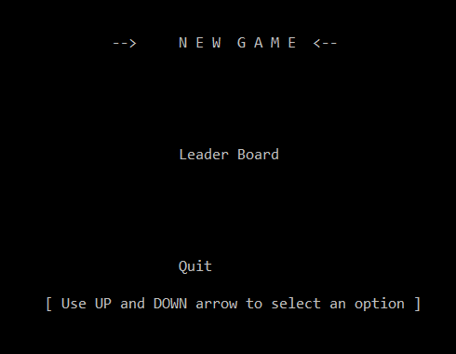
Welcome screen
Opening the program, you’ll be greeted with three options as shown below. You can choose New Game to start a new game, or you can choose leader board to see the current high score.

Slide 4
Functions used
We are using a number of functions to ease up our work and code. The functions used are:
input() : It takes all the words available in dictionary.txt and forms 26 different string arrays to store the words that start with the 26 alphabets respectively.
newGame() : It simply starts a new game.
leaderBoard() : It displays the current high score.
showMatrix() : It displays the whole matrix board, showing block numbers where characters haven’t been placed and showing characters if any character has been placed.
checkhorizontalString() : This functions checks for any horizontal string that might have been formed left-to-right after your input.
checkverticalString() : This functions checks for any vertical string that might have been formed top-to-bottom after your input.
stringSearch() : This function checks whether the formed string is a valid word or not by searching for it in the dictionary.
getChoice() : It’s a function we used to make our welcome screen, to be able to choose the options by using the arrow keys.

Slide 5
eol
The program might still contain some bugs as we couldn’t check all the scenarios involved. However, we tried to implement almost all the features we wanted and somewhat succeeded.
Thank you for your patience!! ☺

